Slide 1


connectYall
The best way to meet people based on their interests!
Notes:
Alexandra - Good morning everyone, I am Alexandra and together with me is Salih and we are going to present you the concept we developed in the past months.
Last presentation - an aplication to make friends based on your hobbies

Slide 2
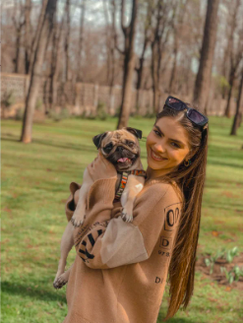
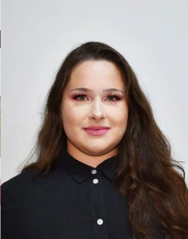
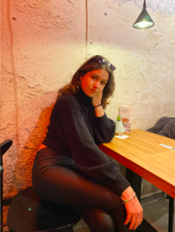
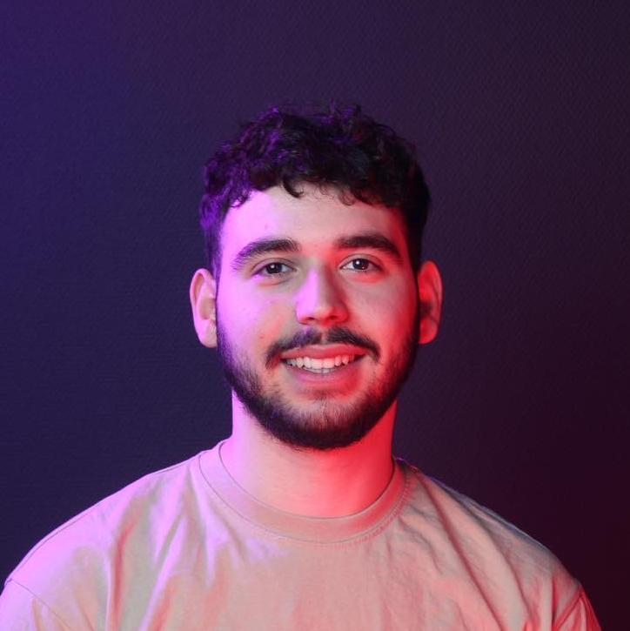
Denisa Zaharia
Denisa Coteanu
Meet The Founders
Alexandra Maftei
Salih Işık
Notes:
With us there are also our other team members, Denisa and Dent, they will be available for the Q&A in the end.

Slide 3
Our inspiration…
A moment when you felt like you had no one to talk to.
Notes:
Alexandra
Now that you have a slight idea about what s coming, let’s go back to the beginnings.
Our inspiration for this project was our personal experience during the lockdown as well as the the lack of a social environment for young people to interact without being objectified by their looks and rather find friends based on hobbies.
In a society where most relations are built on top of physical interaction, it may be rather utopic to think that tackling this social issue is even possible.

Slide 4
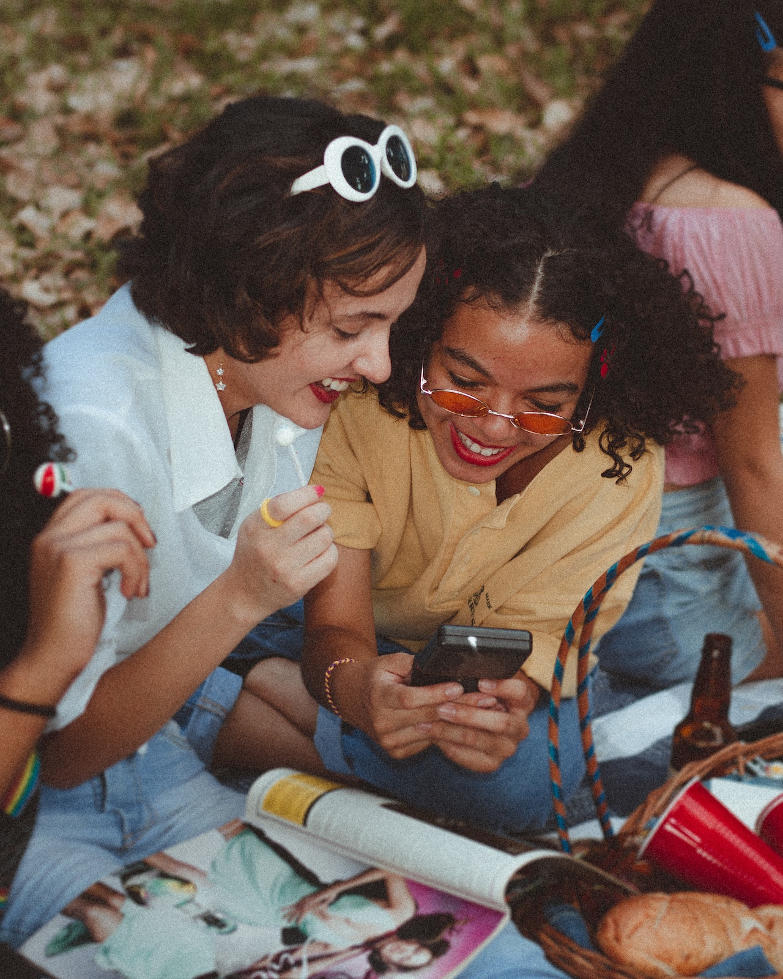
Our mission & vision
connectYall
Shift focus from looks to personality;
Create a safe space;
Promote social interaction.
Notes:
Alexandra -
that being said, in order to come up with the best outcome, we set some clear goals in mind, that we wanted to reflect upon the product we were developing.
It is very important for us, as young people, to have a safe space where we can connect with each other, as well as finding a way to only focus on the things that truly matter, such as personality and character, which we now know should be a priority when forming new friendships.

Slide 5
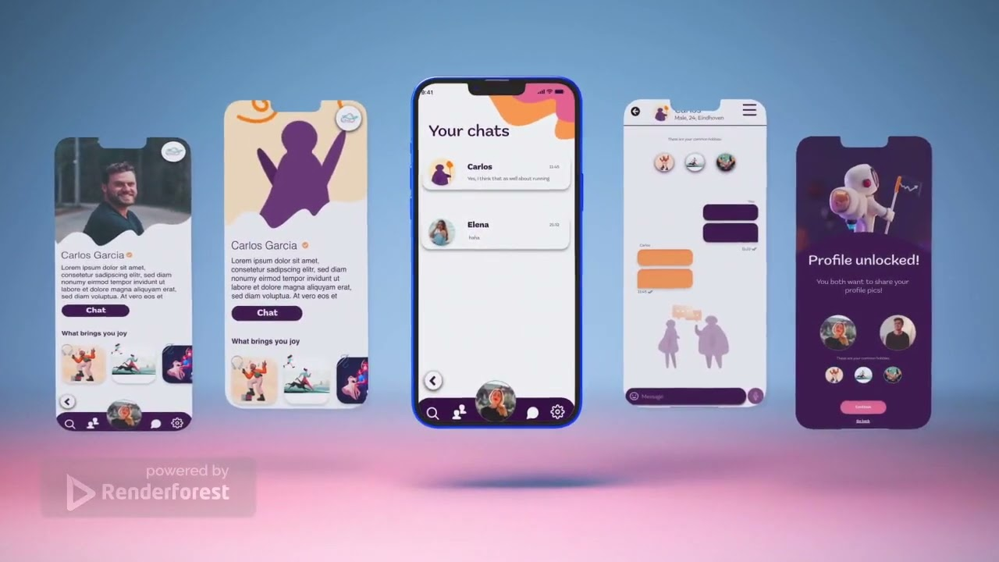
Notes:
Salih
To give little taste of what we are about to dive into, here is a short promo video.

Slide 6

The problem
Notes:
Salih
As studies and experience shows, making friendships without having something in common is really hard and the main problem that comes with this in todays society is that young adults actually lack a safe platform where they can socialise based solely on their common interests, and not be filtered out by their physical attributes.
To be able to solve this issue we obviously had to come up with a solution for it.

Slide 7
Our solution
Create an environment where users find friends based on their interests.
Notes:
Salih
The best way to tackle this problem, was by creating a mobile platform for young people to socialise where interests and hobbies are in the spotlights.
The reason why we chose to make a mobile platform is mainly because most of our target users use their mobile devices a lot, this also came with the benefit that our platform will be more accessible to everyone.

Slide 8
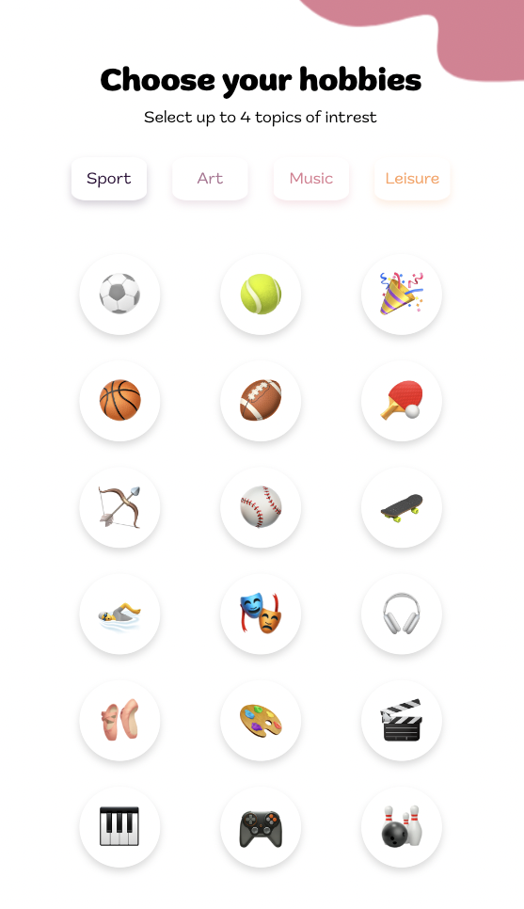
What makes us different
Weekly matches
Our self-made algorithm which gives you weekly matches that are most compatible with you.
Hobbies in the spotlights
Explore endless friendship possibilities - only see their passion!
Safety first
Only show your profile picture if both parties agree upon it.
Notes:
Alexandra
A lot of you already know that there are multiple social applications already on the market. But what makes us stand out from the rest, what are our unique features?
The “star piece” of this product is our algorithm that gives the user perfect weekly matches, of people who are most compatible with them, based on the hobbies they choose when creating an account.
In our product, safety comes first and it is very important that our Users feel safe in the space we ve created. And since we mentioned that we want to shift the focus from looks to personality, we only
allow users to see each other’s profile picture if they both feel comfortable doing so (this usually happens after a few days of chatting).
Last but not least, there are still endless possibilities for you, as an user, to explore and connect to other people, while keeping your identity safe.

Slide 9



How does it work?
Sign Up
Choose your hobbies
Browse
Make friends
Have fun!
Notes:
Salih
I can already hear you say “Well how does this app work?”.
So the very first step is of course signing up through our sign up page using your credentials.
After that you will be redirected to our so called hobbyspage where you will be able to browse through and select up to 4 hobbies and intrests.
When you’ve completed these steps you will be able to explore and socialise or become friends with people who have the same hobbies and interests.
Having a common hobby with your newly made friends will then result in you having more fun with others and spending less time alone at home.
You may still have differences but these can actually help you explore new hobbies of which you didn’t know you liked.

Slide 10
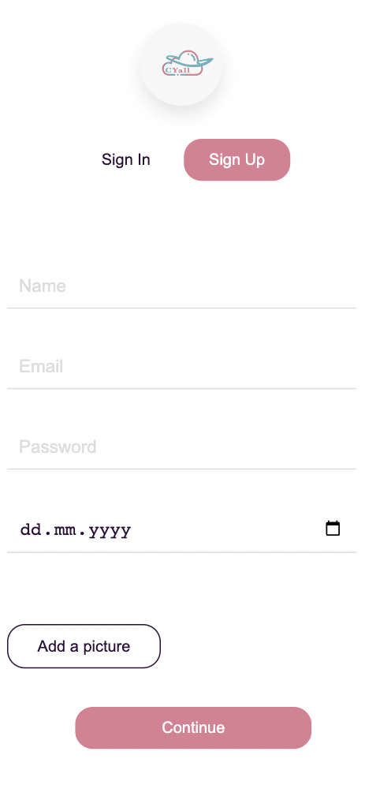
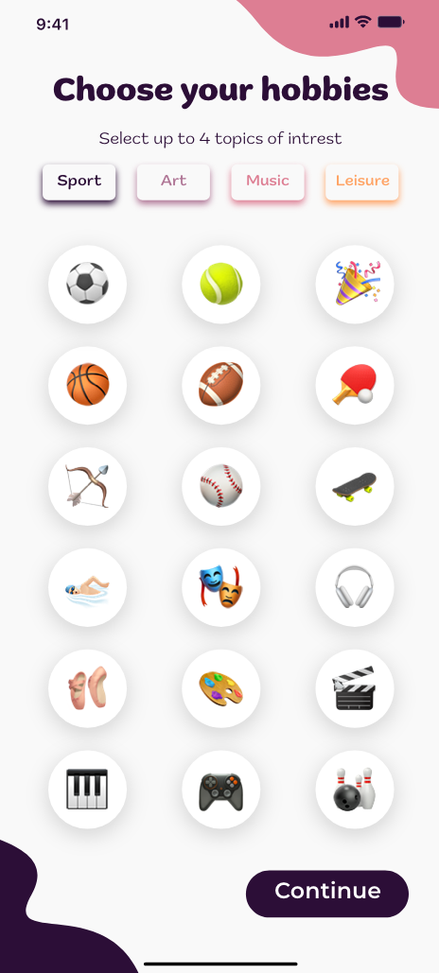
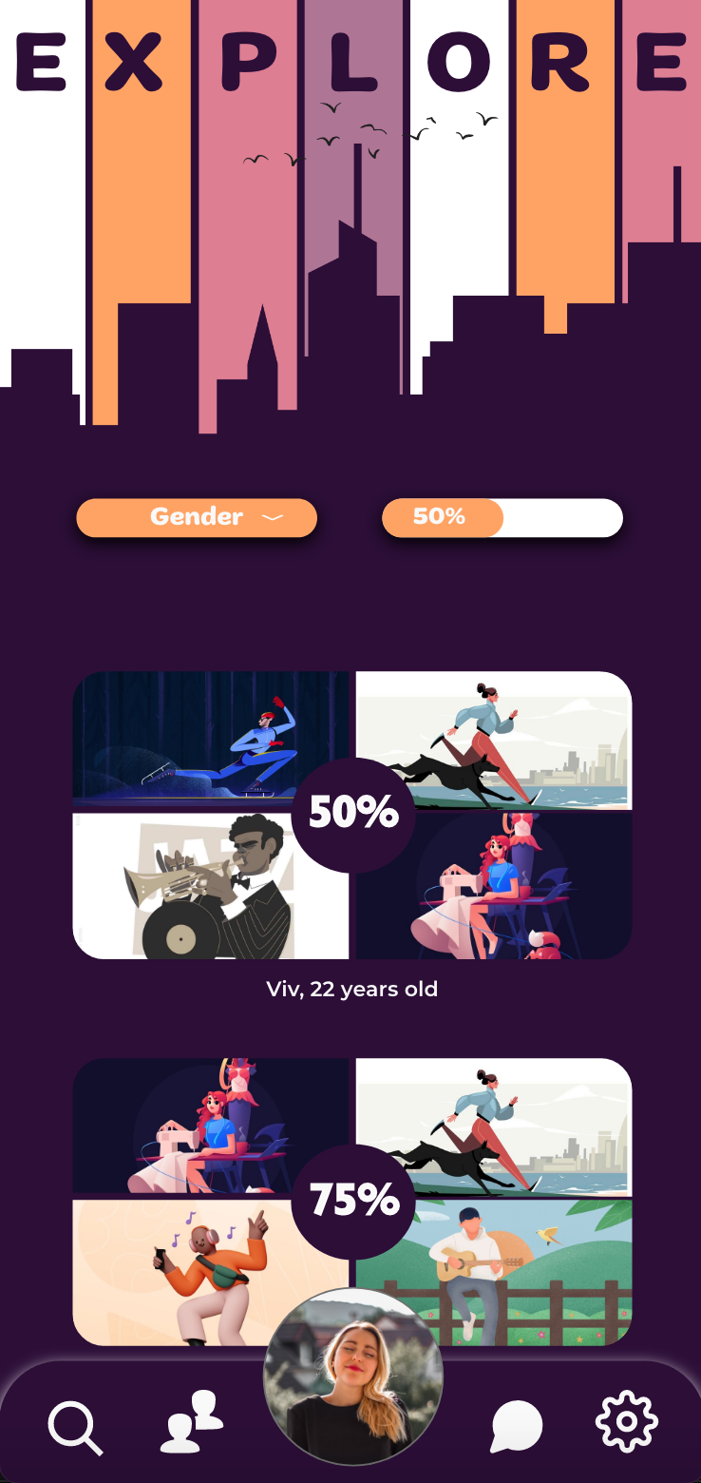
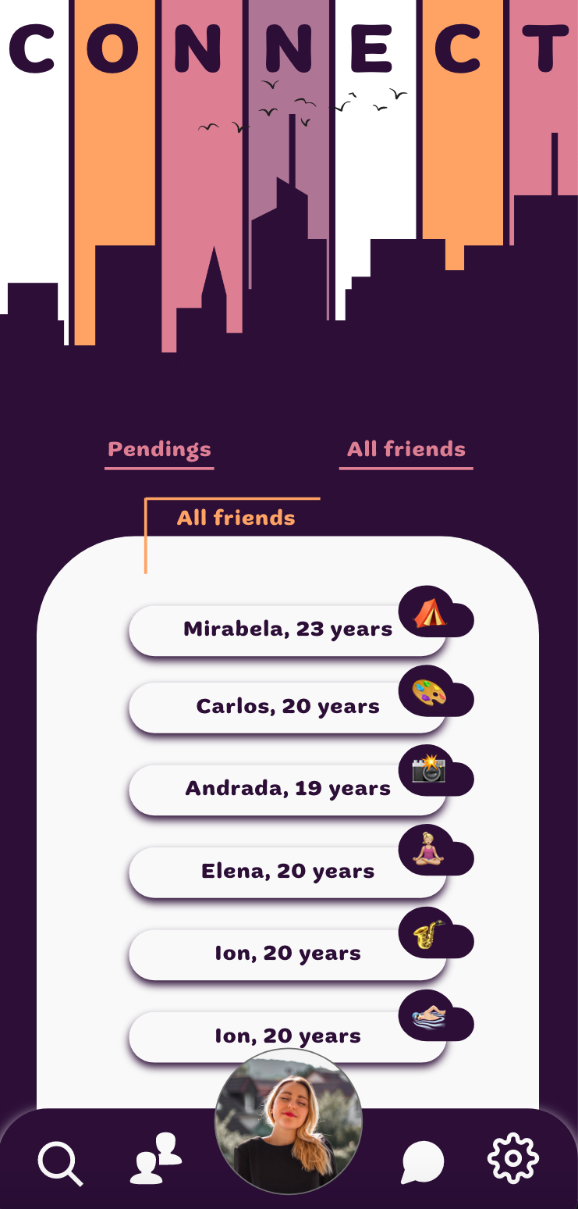
Notes:
Alexandra - Now it is time to see our product in action.

Slide 11
Future plans
Notes:
introduce (small) ads
smoother interactions
Promo materials -through already existing social media channels

Slide 12

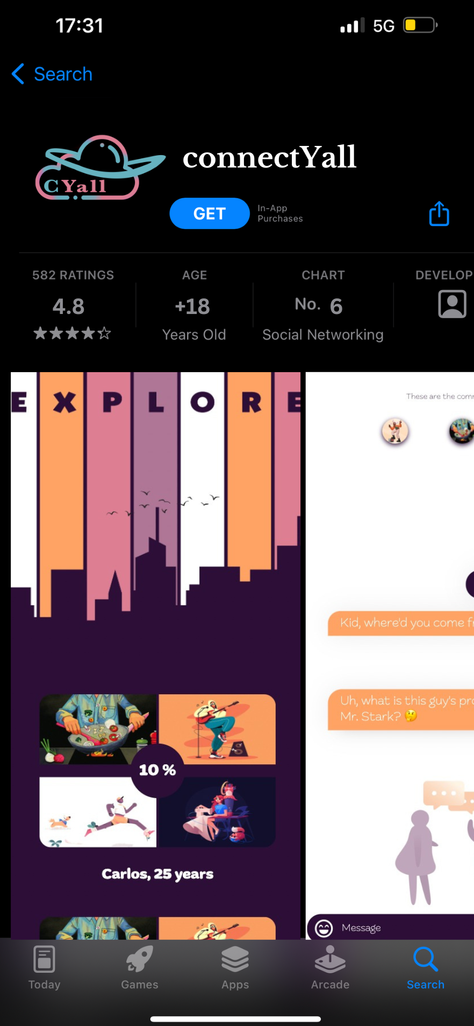
Soon available in your favourite virtual store!
App Store
Play Store
Notes:
Salih
connectYall will soon be available on all of your favourite online marketplaces!
Thank you for listening.

